Slide 1

Machine Learning
ICT-
By-
Dr. Jesmin Akhter
Professor
Institute of Information Technology
Jahangirnagar University

Slide 2
Contents
The course will mainly cover the following topics:
Ensemble Learning
Unsupervised Learning
Clustering Fundamentals
Hierarchical Clustering
………………………..
Neural Networks and Deep Learning
Notes:
More Supervised - Adaboost Gradient boosting Xgboost

Slide 3
Exam schedule
Tutorial | Date and Time
Tutorial-01 | After 3 classes
Tutorial-02 | After 6 classes
Tutorial-03 | After 9 classes
NB: Schedule may change

Slide 4
Outline
Ensemble Learning
Notes:
https://iq.opengenus.org/cart-algorithm/

Slide 5
Ensemble Learning
Ensemble methods refer to the techniques used in machine learning to combine multiple base models to achieve better predictive performance.
By combining multiple models, ensemble methods can help to reduce the risk of overfitting, improve the accuracy and stability of predictions, and provide a more robust and reliable predictor.
The term “model” to describe the output of the algorithm that trained with data. This model is then used for making predictions. This algorithm can be any machine learning algorithm such as logistic regression, SVM, decision tree, etc. These models, when used as inputs of ensemble methods, are called ”base models,” and the end result is an ensemble model.
It combines low performing classifiers (also called as weak learners or base learner) and combine individual model prediction for the final prediction.
On the basis of type of base learners, ensemble methods can be categorized as homogeneous and heterogeneous ensemble methods. If base learners are same, then it is a homogeneous ensemble method. If base learners are different then it is a heterogeneous ensemble method.
Ensemble methods are widely used in various applications, including image classification, natural language processing, and financial market prediction
Notes:
Example If you are planning to buy an air-conditioner, would you enter a showroom and buy the air-conditioner that the salesperson shows you? The answer is probably no. In this day and age, you are likely to ask your friends, family, and colleagues for an opinion, do research on various portals about different models, and visit a few review sites before making a purchase decision. You would not come to a conclusion directly. Instead, you would try to make a more informed decision after considering diverse opinions and reviews. In the case of ensemble learning, the same principle applies
By analogy, ensemble techniques have been used also in unsupervised learning scenarios, for example in consensus clustering or in anomaly detection.

Slide 6
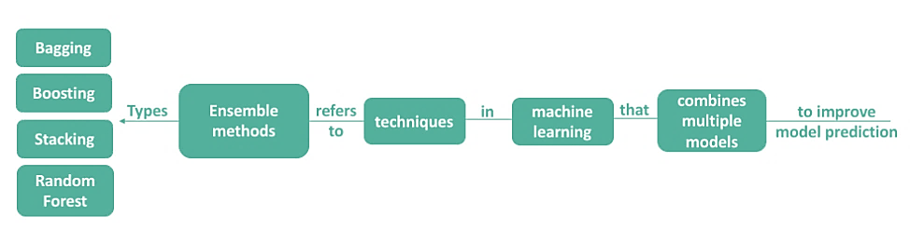
Main Types of Ensemble Methods
Random Forest
voting

Slide 7
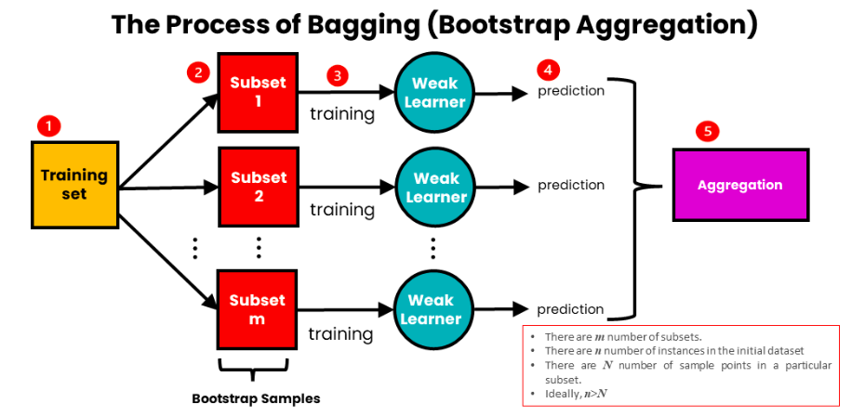
Bagging
Bagging (bootstrap aggregating) is an ensemble method that involves training multiple models independently on random subsets of the data, and aggregating their predictions through average (for regression) or majority vote (for classification). It is a parallel approach. Random Forest is a special case of Bagging.
How Does Bagging Work?
Generate D₁ D₂ D₃….D_{m} subsets randomly from the original dataset, selecting observations with replacement. The size of subsets created for bagging may be less than the original set
Generate base model (weak model) M₁ M₂ M₂ ….M_{m} on each of these subsets.
The models run in parallel and are independent of each other. so they have different perspectives on the problem.
The predictions from m models are combined by taking the average (for regression) or majority vote (for classification) of their predictions. This produces the final prediction of the bagged model.
Notes:
https://www.analyticsvidhya.com/blog/2023/01/ensemble-learning-methods-bagging-boosting-and-stacking/
https://www.youtube.com/watch?v=WAipXytDeK0

Slide 8
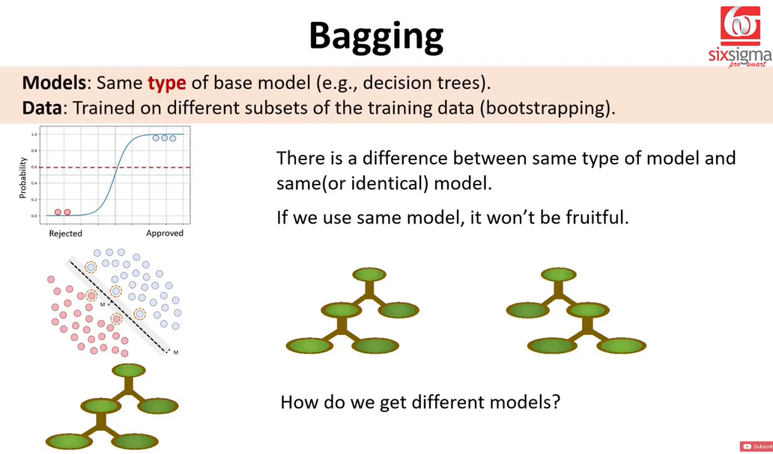

Slide 9
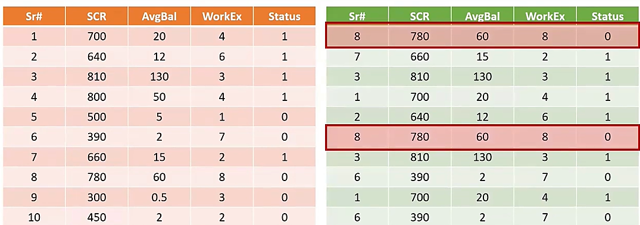
Some of the observations is selected multiple times

Slide 10
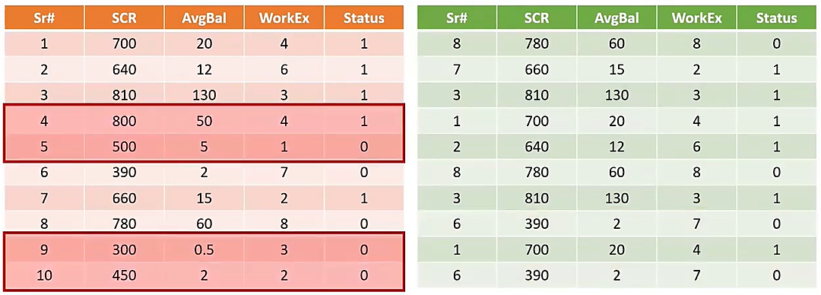

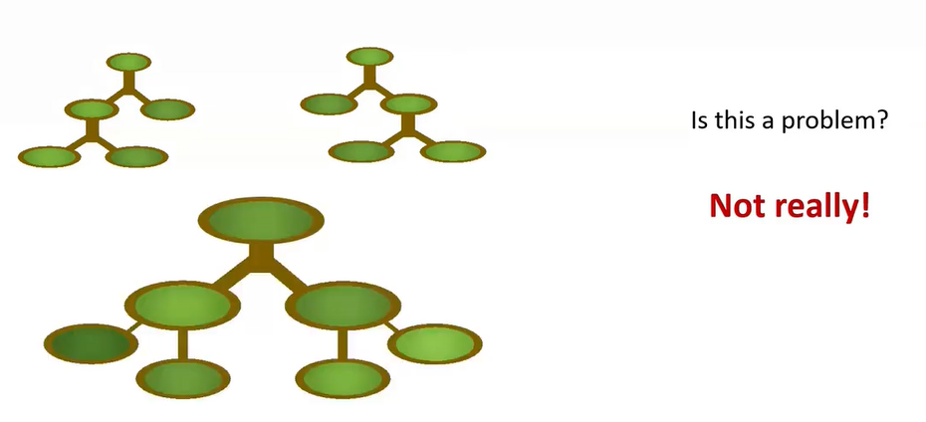
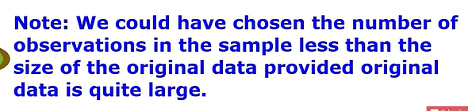
Record no 4, 5, 9, 10 are not selected from the original.
That’s not really a problem why? we don’t create a single decision tree but create a multiple decision trees and for each decision tree we are doing this sampling again and again. So there could be many decision trees that will be creating and for each decision tree we are going to do this bootstrapping again and again. So the sample is different.
Example record 4,5, 9 and 10 did not get selected for the first decision tree , may be selected for the some other decision tree.. This approach to bagging is known as row sampling approach
Why because we repeatedly sample the rows with a replacement
Notes:
https://www.youtube.com/watch?v=WAipXytDeK0

Slide 11
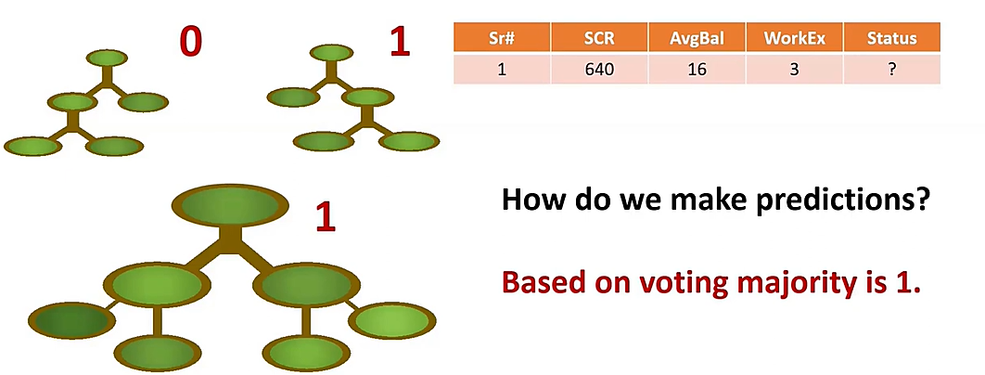
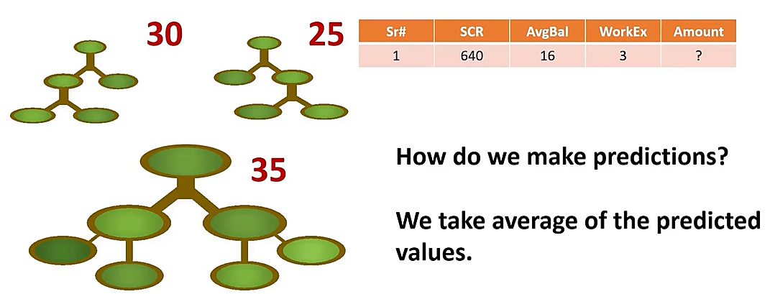
Average=30

Slide 12
Advantages
By combining multiple models, bagging helps reduce the model’s variance and can prevent overfitting by introducing diversity into the training process. It is commonly used with decision trees but can also be applied to other models.
One important aspect of bagging is that it requires the base model to have high variance but low bias(DT). Bagging can then be used to reduce the variance of the model and improve its generalization performance on new, unseen data.
Data overlap are allowed between base learners.

Slide 13
Why Bagging’s variance is smaller?
Expected distinct data points in each bag?
N.(1 − (1-1/N^{)N)} ~ N(1 - exp(-1)) ~ 0.632. N [N=No of Records]
Where:
P (each data point being selected) = 1/N
P (data point not selected in N trials) = (1-1/N)^{N}
Why Bagging's Variance is smaller?
Reduces Variance: By averaging the predictions of multiple models, bagging smooths out the noise and fluctuations that individual models might capture. This leads to lower variance in the predictions because the errors from individual models tend to cancel each other out when aggregated.
Retains Bias: The individual models (e.g., decision trees) still have their own inherent bias. Bagging does not change the fundamental bias of each model; instead, it simply combines them. Thus, while the overall prediction becomes more stable (lower variance), the underlying bias of the individual models remains the same.
Assume we measure a random variable x with N(μ, σ²) distribution
If random variable x is measured T times (x₁, x₂,...x_{T}) and a new variable is constructed as (x₁+x₂+…..+x_{T})/T. then
Mean of the estimate will be still μ
But, variance is smaller (Var(x₁) + Var(x₂)+…..+Var(x_{T}))/T² = Τ.σ²/T² = σ²/T

Slide 14
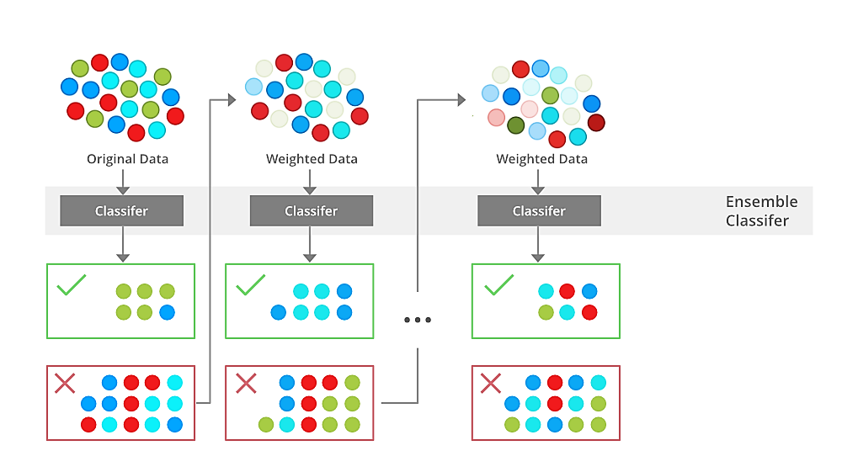
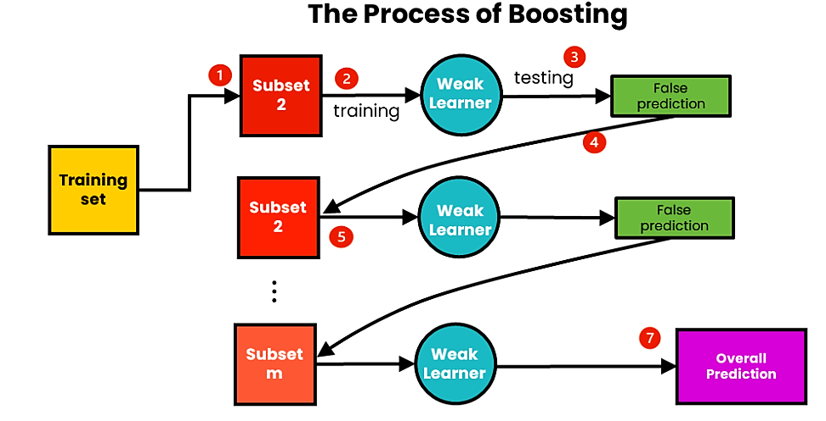
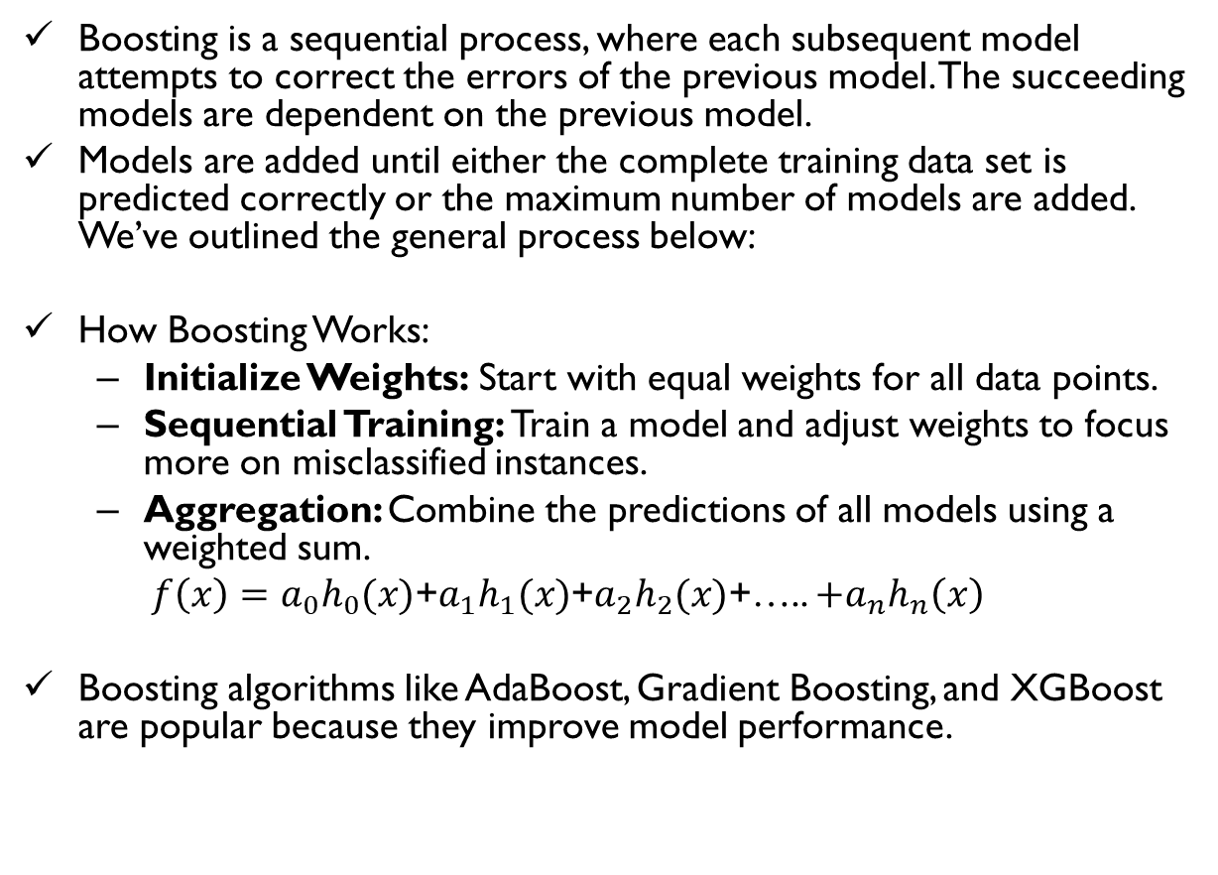
How Boosting Works
Boosting is a sequential process, where each subsequent model attempts to correct the errors of the previous model. The succeeding models are dependent on the previous model.
Models are added until either the complete training data set is predicted correctly or the maximum number of models are added. We’ve outlined the general process below:
How Boosting Works:
Initialize Weights: Start with equal weights for all data points.
Sequential Training: Train a model and adjust weights to focus more on misclassified instances.
Aggregation: Combine the predictions of all models using a weighted sum.
$f\left(x\right)=a_{0}h_{0}(x)$+$a_{1}h_{1}(x)$+$a_{2}h_{2}(x)$+….. ${+a}_{n}h_{n}\left(x\right)$
Boosting algorithms like AdaBoost, Gradient Boosting, and XGBoost are popular because they improve model performance.

Slide 15
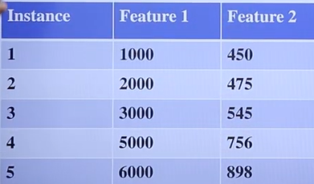
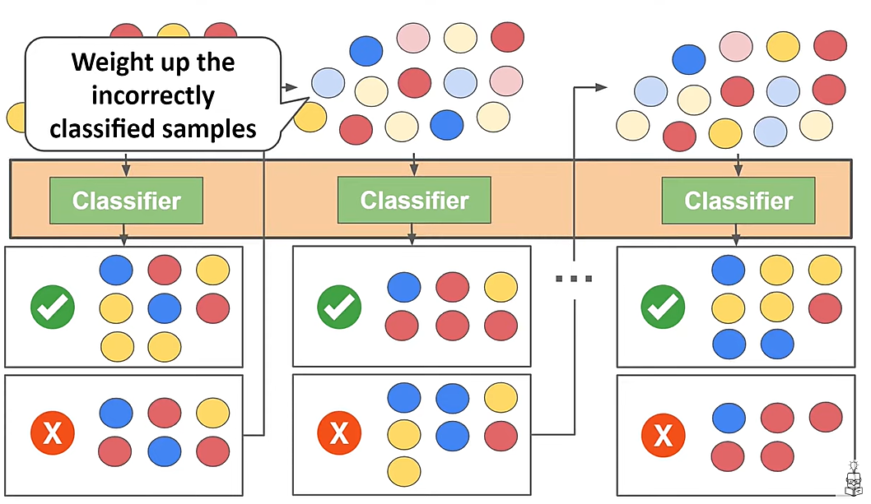
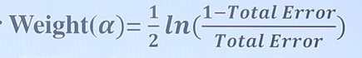
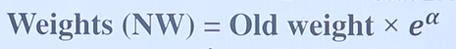
How Weights are Increased in Boosting

Slide 16
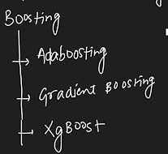
Types of Boosting
Adaptive boosting (AdaBoost) weights model errors. That is, when creating a new iteration of a dataset for training the next learner, AdaBoost adds weights to the previous learner’s misclassified samples, causing the next learner to prioritize those misclassified samples.
Gradient boosting uses residual errors when training new learners. Rather than weight misclassified samples, gradient boosting uses residual errors from a previous model to set target predictions for the next model. In this way, it attempts to close the gap of error left by one model.
Notes:
https://www.youtube.com/watch?v=l3DzJBb3MaE&t=748s

Slide 17
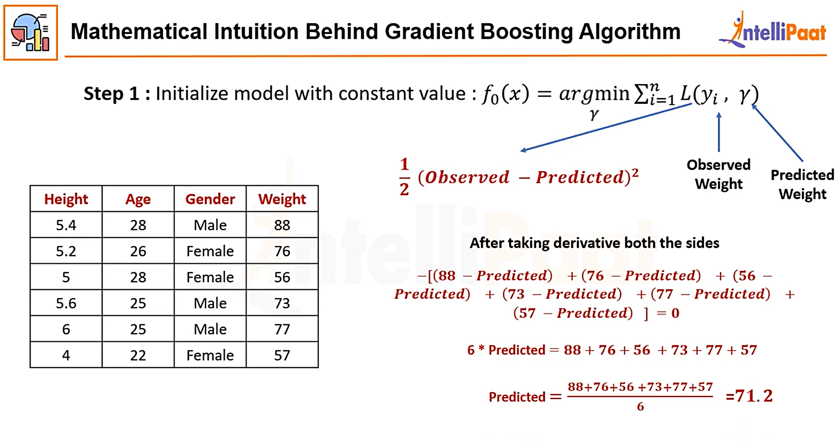
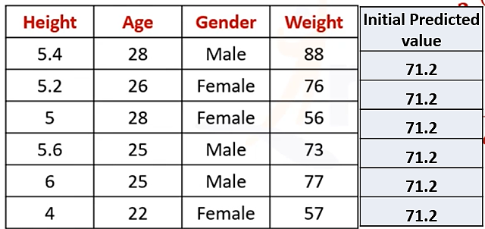
Solved Example 01

Slide 18
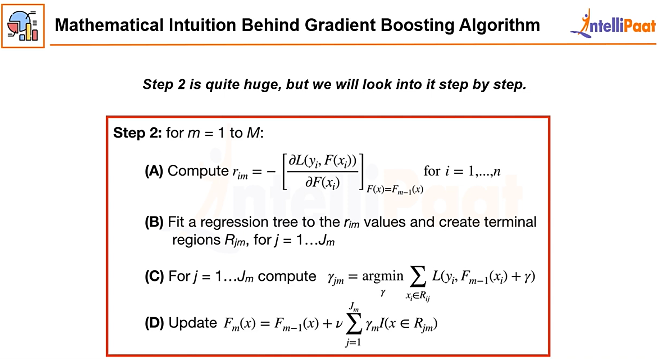
Compute Average of residual from terminal nodes

Slide 19
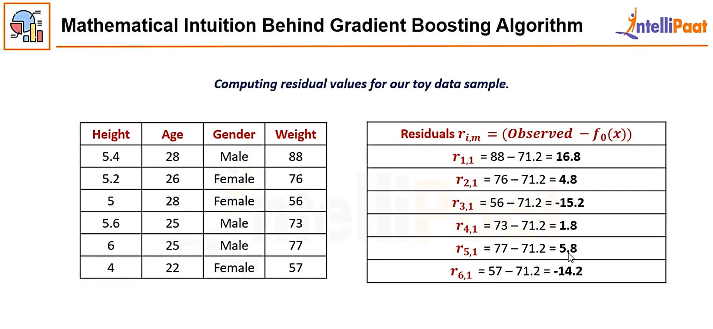
Step 02 – A: Calculate Residuals

Slide 20
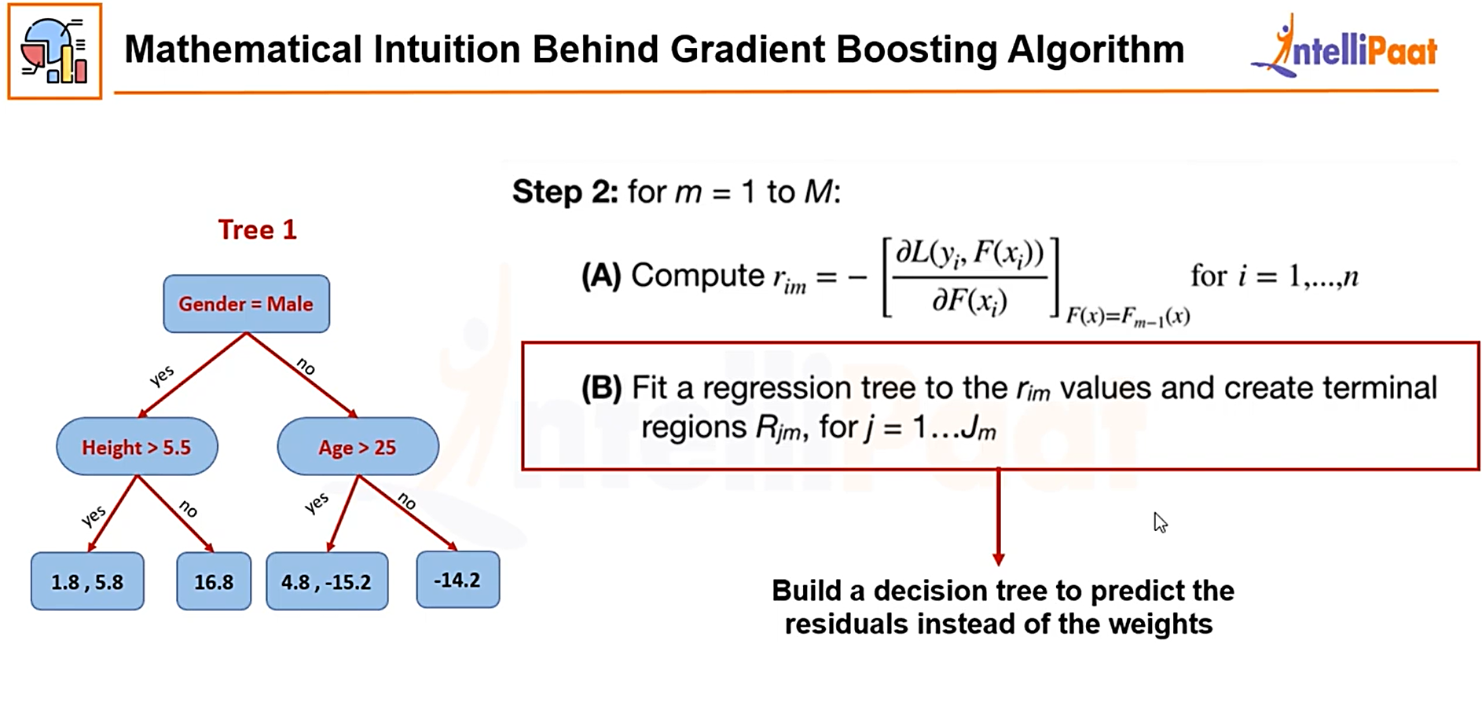
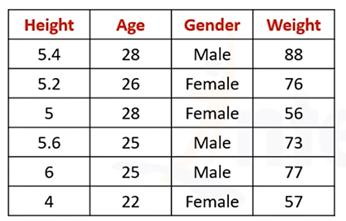
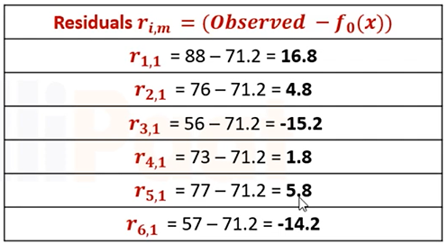
Step 02 – B: Build a regression Tree and fit to the residual value

Slide 21
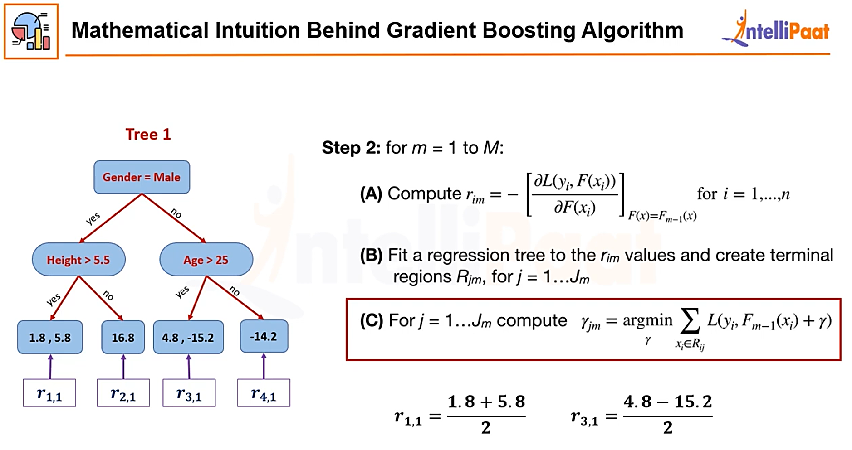
Step 02- (C) Round up Terminal nodes
Compute Average of residual from terminal nodes
Round up Terminal nodes

Slide 22
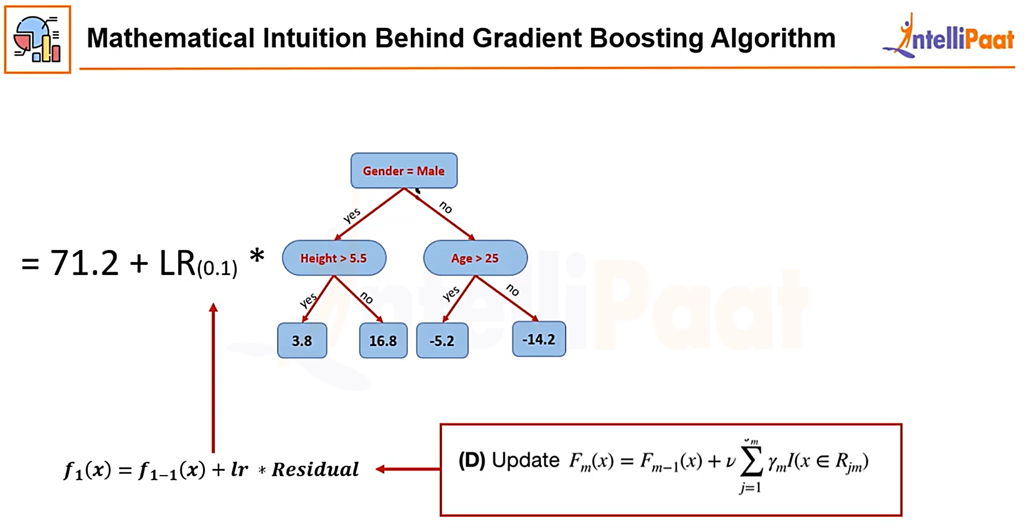
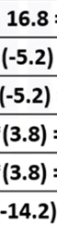
Step 02 – D: Update predicted value=Previous predicted value + Learning Rate * Residual from Tree.
Residual from Tree

Slide 23
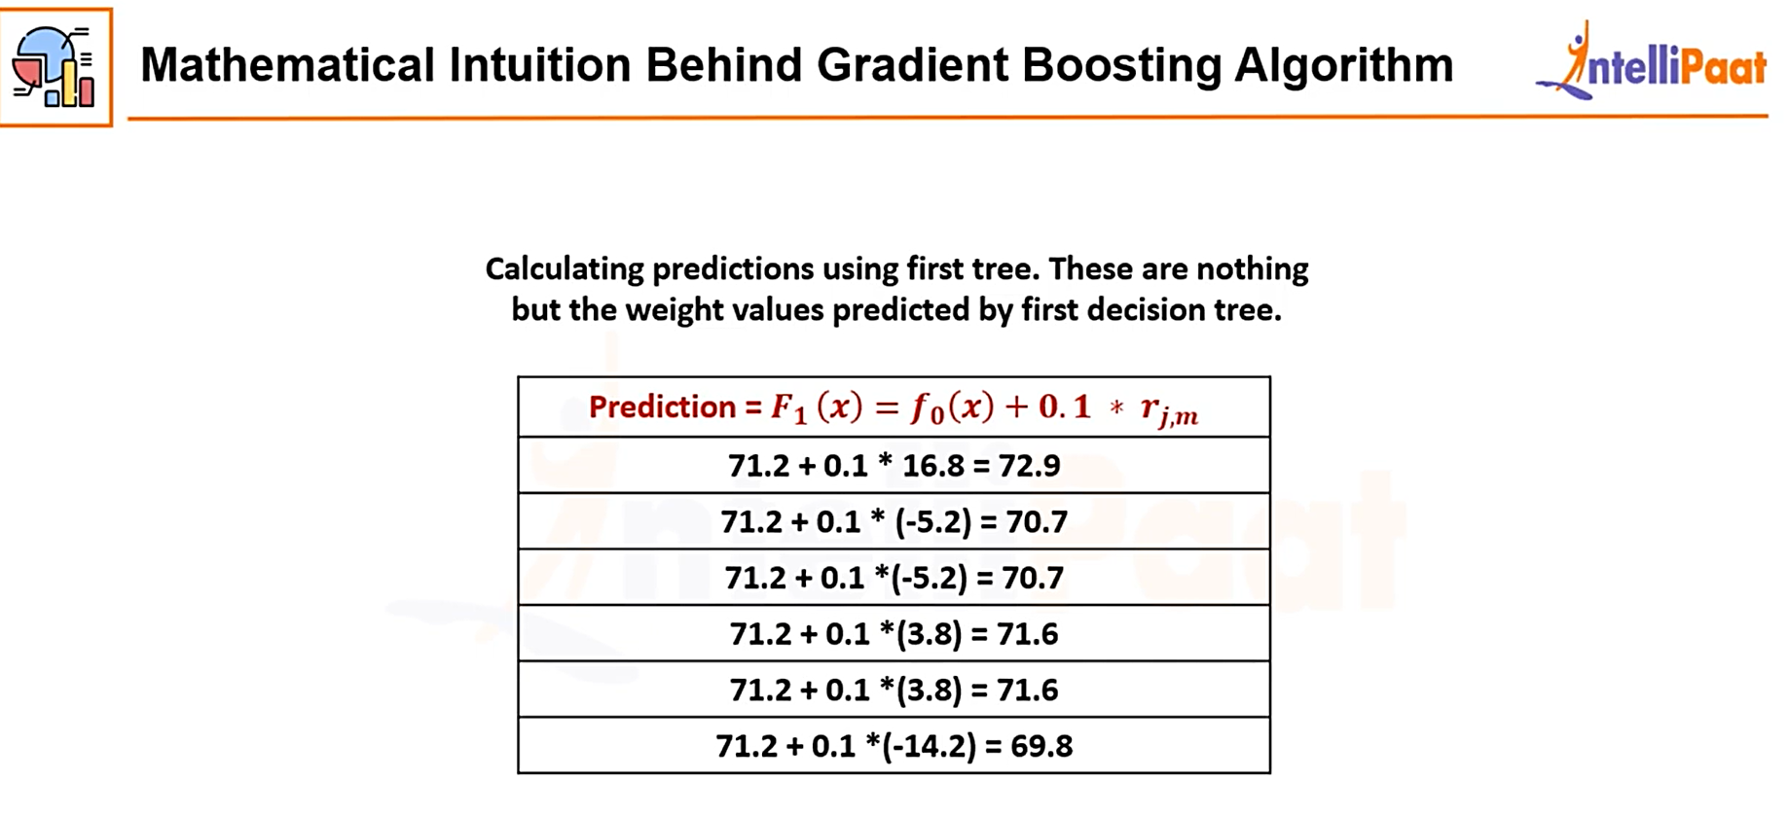
Step 02 – D: Update predicted value=Previous predicted value + Learning Rate * Residual from Tree.

Slide 24
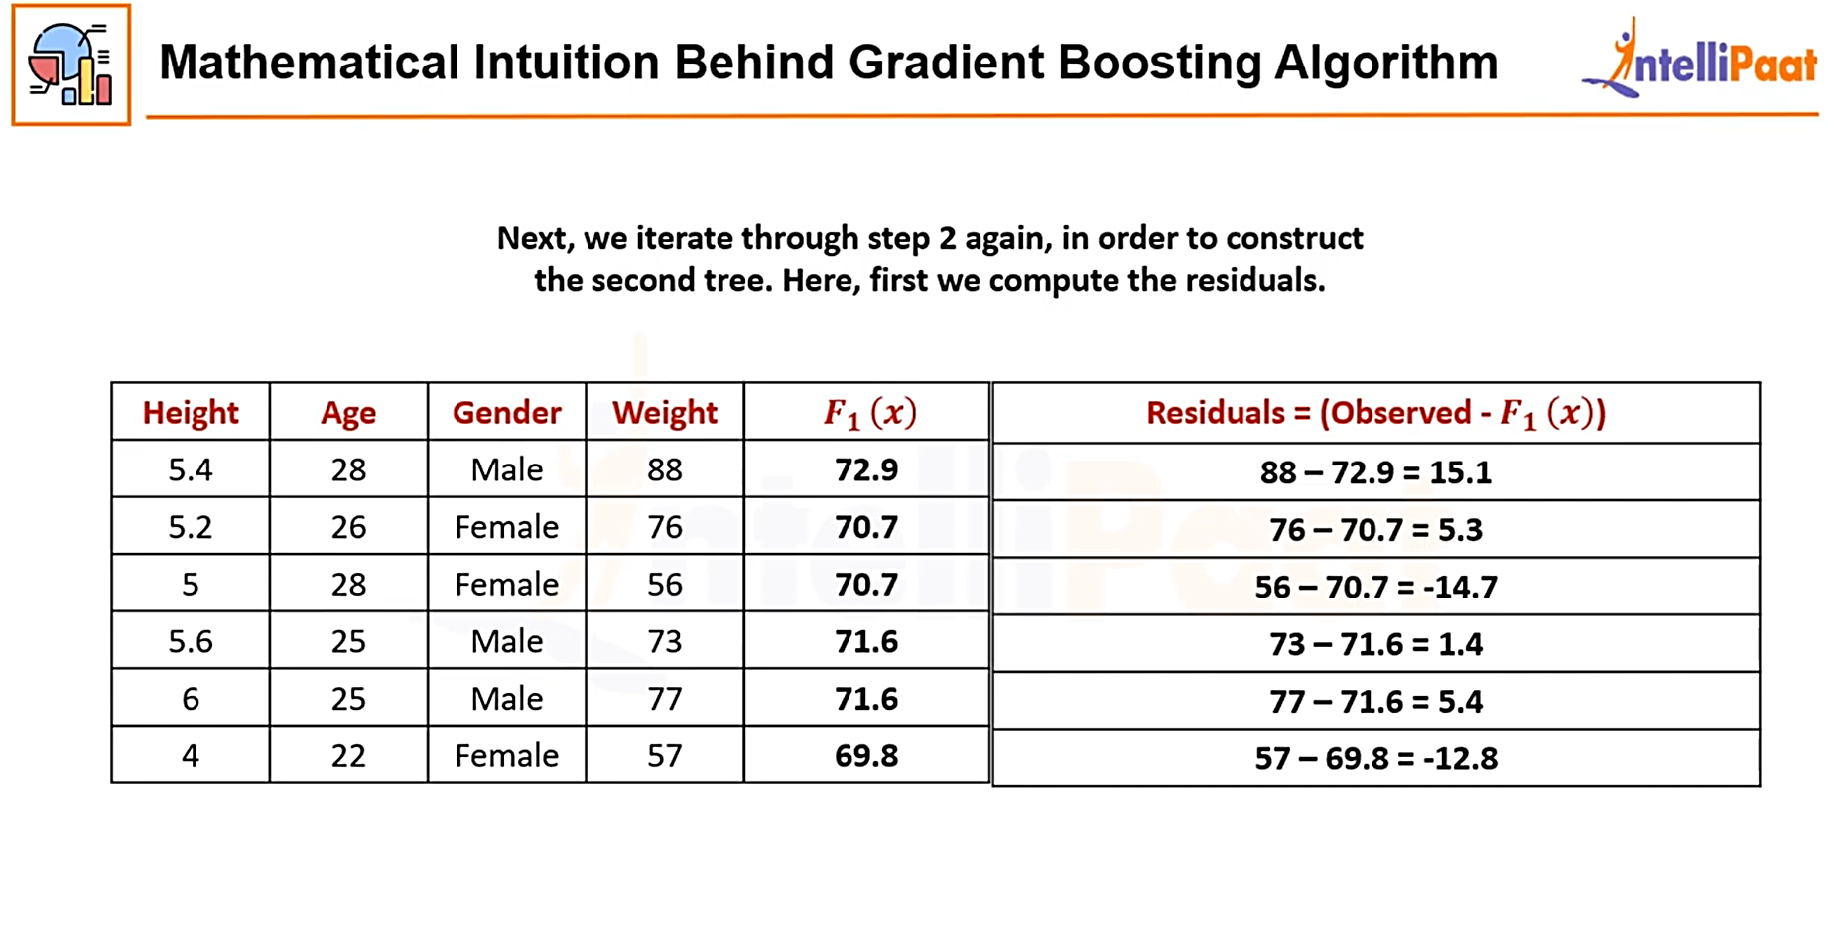
Step 02 – A: Calculate Residuals

Slide 25
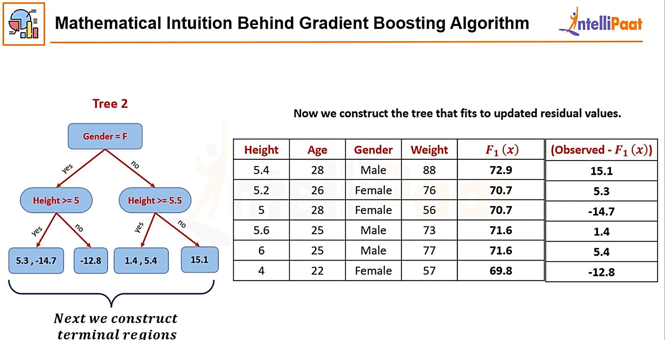
Step 02 – B: Build a regression Tree and fit to the updated residual value

Slide 26
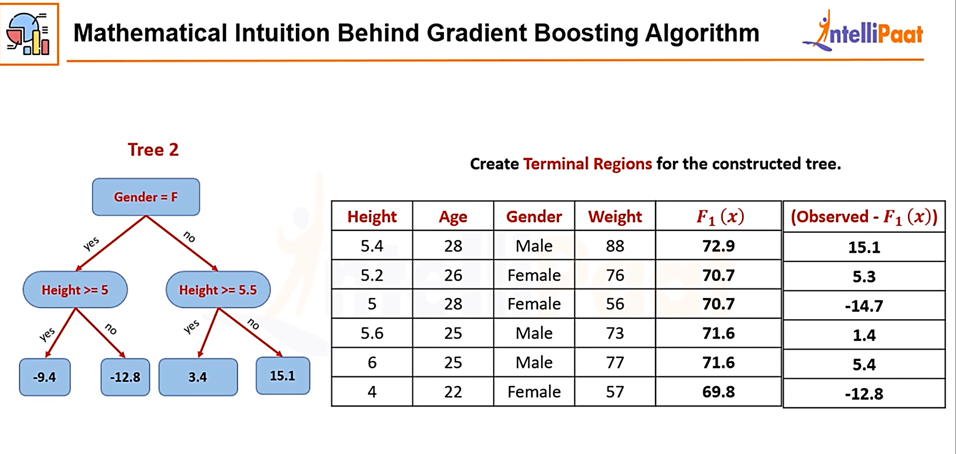
Step 02- (C) Round up Terminal nodes
Residual
from Tree
15.1
-4.7
-4.7
3.4
3.4
-12.8
-4.7

Slide 27
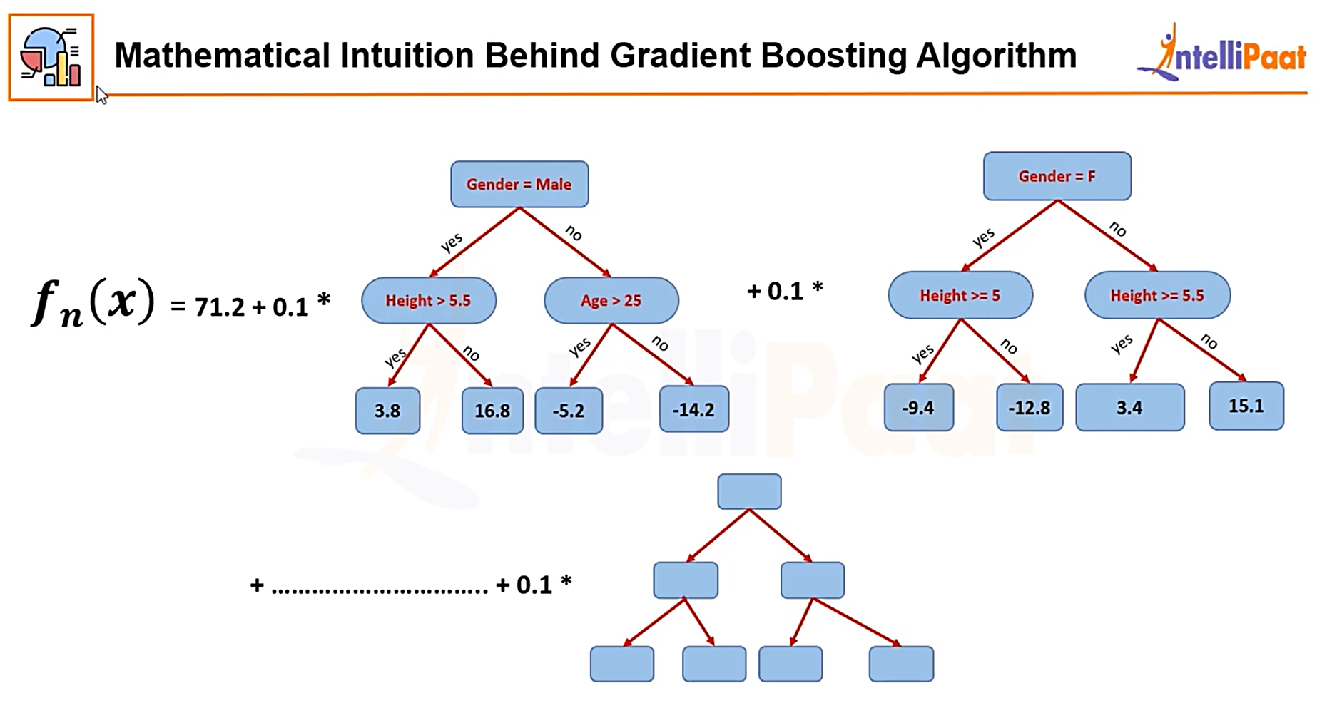
Step 02 – D: Update predicted value=Previous predicted value + Learning Rate * Residual from Tree.
f_{n}(x)=72.9
-4.7
Prediction=F₂(x)=F₁(x)+0.1*r_{j,m}
72.9+0.1*15.1=74.41
70.7+0.1*-4.7=70.23
70.7+0.1*-4.7=70.23
71.6+0.1*3.4=71.94
71.6+0.1*3.4=71.94
69.8+0.1*-12.8=68.52

Slide 28
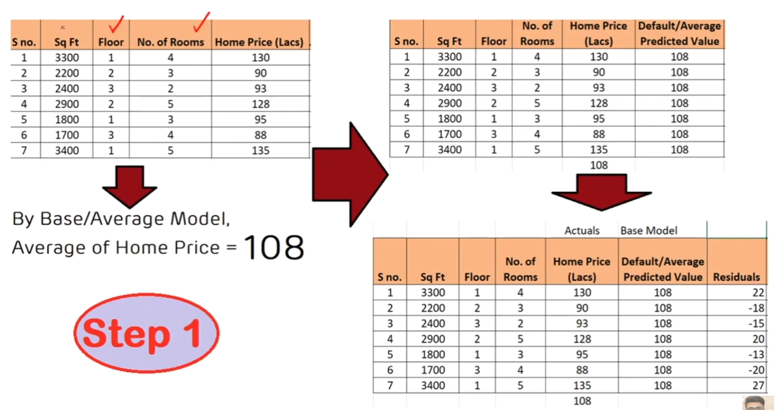
Solved Example 02

Slide 29
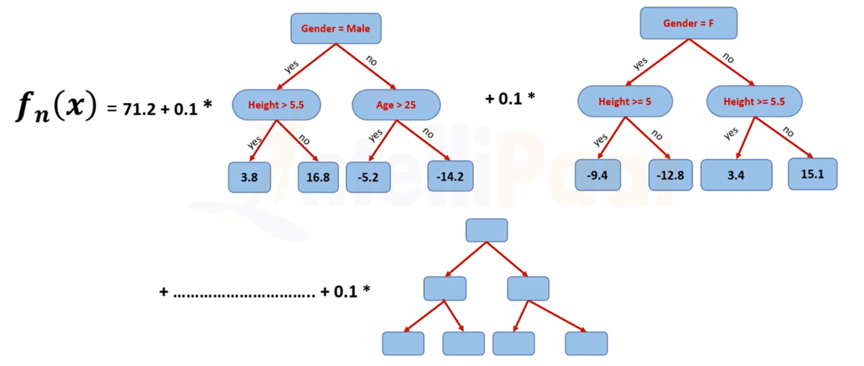
Solved Example 02(Extended Full Concept)
New Prediction=Average Predicted Prices+Learning rate* The tree mode on resudals
Resudal=Target - Predicted
F_{n}(x)=108+ 0.4*
+ 0.4*
Need to be corrected
+ 0.4*
S no. | Sq Ft | Floor | No of Rooms | Home Prices(Lac) | Average pred | residual 01 | New Pred | Residual 02 | New Pred | Residual 03 | New Pred | Residual 04 | New | Residual 04 | New
1 | 3300 | 1 | 4 | 130 | 108 | 22 | 116.8 | 13.2 | 122.08 | 7.92 | 125.248 | 4.752 | 127.1488 | 2.8512 | 128.2893
2 | 2200 | 2 | 3 | 90 | 108 | -18 | 100.8 | -10.8 | 96.48 | -6.48 | 93.888 | -3.888 | 92.3328 | -2.3328 | 91.39968
3 | 2400 | 3 | 2 | 93 | 108 | -15 | 102 | -9 | 98.4 | -5.4 | 96.24 | -3.24 | 94.944 | -1.944 | 94.1664
4 | 2900 | 2 | 5 | 128 | 108 | 20 | 116 | 12 | 120.8 | 7.2 | 123.68 | 4.32 | 125.408 | 2.592 | 126.4448
5 | 1800 | 1 | 3 | 95 | 108 | -13 | 102.8 | -7.8 | 99.68 | -4.68 | 97.808 | -2.808 | 96.6848 | -1.6848 | 96.01088
6 | 1700 | 3 | 4 | 88 | 108 | -20 | 100 | -12 | 95.2 | -7.2 | 92.32 | -4.32 | 90.592 | -2.592 | 89.5552
7 | 3400 | 1 | 5 | 135 | 108 | 27 | 118.8 | 16.2 | 125.28 | 9.72 | 129.168 | 5.832 | 131.5008 | 3.4992 | 132.9005
 |  |  | Sum | 108

Slide 30
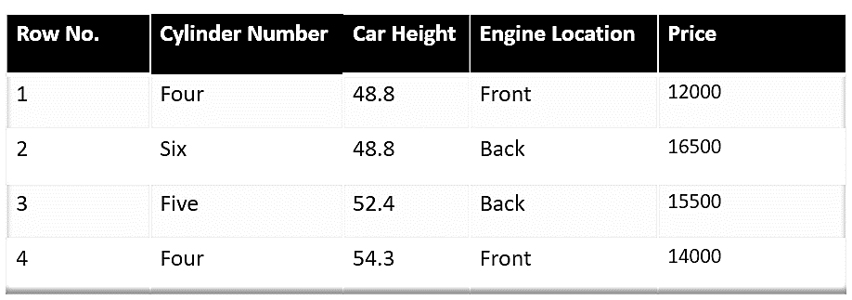
Gradient boosting-Example 03
The following is a sample from a random dataset in which we must predict the car price based on various features. The target column is price, and the other features are independent.

Slide 31
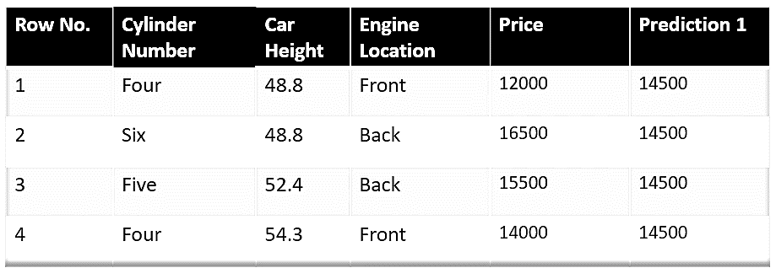
Step 1: Build a Base Model
The first step in gradient boosting is to build a base model to predict the observations in the training dataset. For simplicity, we take an average of the target column and assume that to be the predicted value as shown below:
Notes:
https://www.analyticsvidhya.com/blog/2021/09/gradient-boosting-algorithm-a-complete-guide-for-beginners/

Slide 32
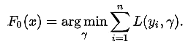
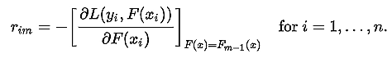
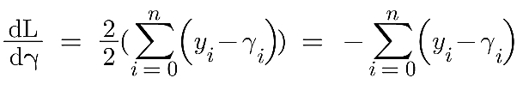
Mathematically the first step can be written as:
Here L is our loss function, Gamma is our predicted value, and arg min means we have to find a predicted value/gamma for which the loss function is minimum.
Since the target column is continuous our loss function will be:
Here y_{i} is the observed value, and gamma is the predicted value.
Now, we need to find a minimum value of gamma such that this loss function is minimum. We all studied how to find minima and maxima in 12th grade. Did we use them to differentiate this loss function and then put it equal to 0, right? Yes, we will do the same here.

Slide 33
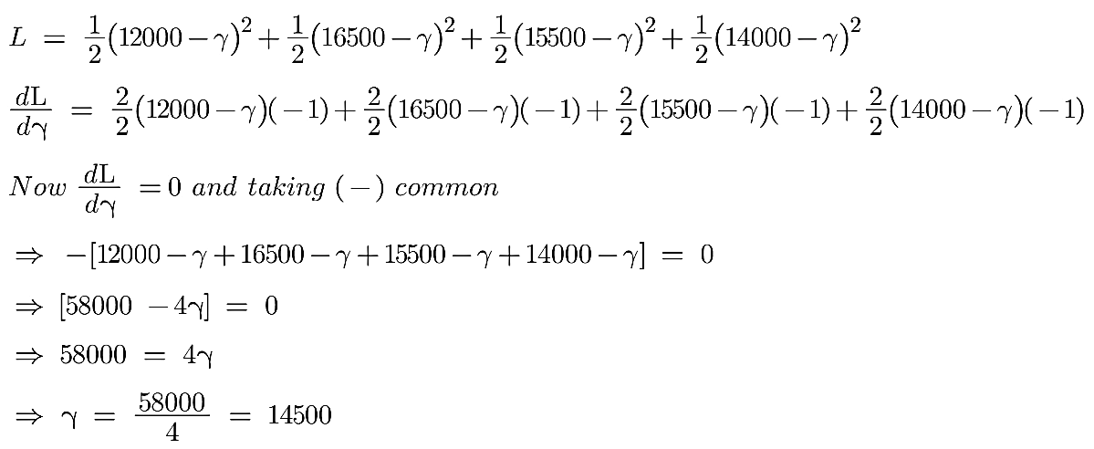
Let’s see how to do this with the help of our example. Remember that y_i is our observed value, and gamma_i is our predicted value. By plugging the values in the above formula,a we get:

Slide 34
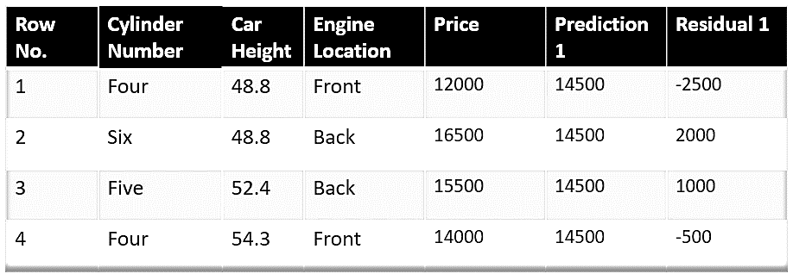
Hence for gamma=14500, the loss function will be minimum so this value will become our prediction for the base model.
Step 2: Compute Pseudo Residuals
The next step is to calculate the pseudo residuals which are (observed value – predicted value).

Slide 35
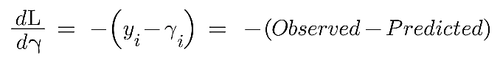
Again the question comes why only observed – predicted? Everything is mathematically proven. Let’s see where this formula comes from. This step can be written as:
Here F(x_{i}) is the previous model and m is the number of DT made.
We are just taking the derivative of the loss function w.r.t the predicted value and we have already calculated this derivative:

Slide 36
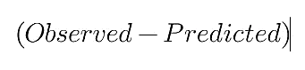
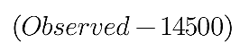
If you see the formula of residuals above, we see that the derivative of the loss function is multiplied by a negative sign, so now we get:
The predicted value here is the prediction made by the previous model. In our example the prediction made by the previous model (initial base model prediction) is 14500, to calculate the residuals our formula becomes:
Step 3: Build a Model on Calculated Residuals
In the next step, we will build a model on these pseudo residuals and make predictions. Why do we do this? Because we want to minimize these residuals, minimizing them will eventually improve our model accuracy and prediction power. So, using the residual as a target and the original feature, the cylinder number, cylinder height, and engine location, we will generate new predictions. Note that the predictions, in this case, will be the error values, not the predicted car price values, since our target column is an error now.
Let’s say h_{m}(x) is our DT made on these residuals.

Slide 37
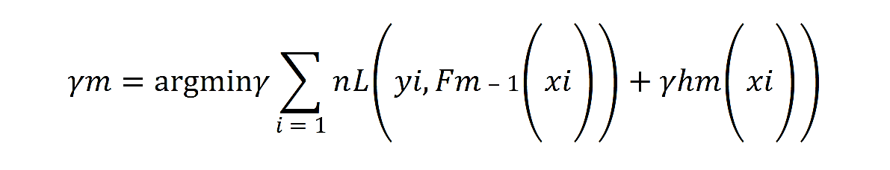
Step 4: Compute Decision Tree Output
In this step, we find the output values for each decision tree leaf. That means there might be a case where one leaf gets more than one residual, so we need to find the final output of all the leaves. To find the output, we can simply take the average of all the numbers in a leaf; it doesn’t matter if there is only one number or more than one.
Let’s see why we take the average of all the numbers. Mathematically this step can be represented as:
Here, hm(xi) is the DT made on residuals, and m is the number of DTs. When m=1, we are talking about the first DT, and when it is “M,” we are talking about the last DT.
The leaf’s output value is the gamma value that minimizes the Loss function. The left-hand side “Gamma” is the output value of a particular leaf. On the right-hand side [F m-1 (x i )+ƴh m (x i ))] is similar to step 1 but here the difference is that we are taking previous predictions whereas earlier there was no previous prediction.

Slide 38
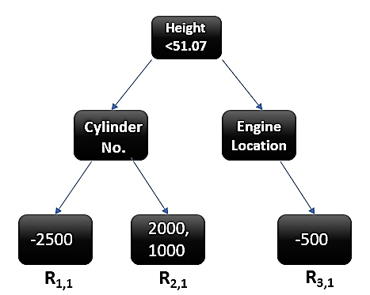
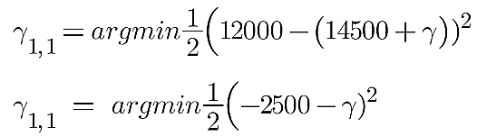
Example of Calculating Regression Tree Output
Let’s understand this even better with the help of an example. Suppose this is our regressor tree:
We see 1st residual goes in R_{1,1} ,2nd and 3rd residuals go in R_{2,1} and 4th residual goes in R_{3,1} .
Let’s calculate the output for the first leave that is R_{1,1}

Slide 39
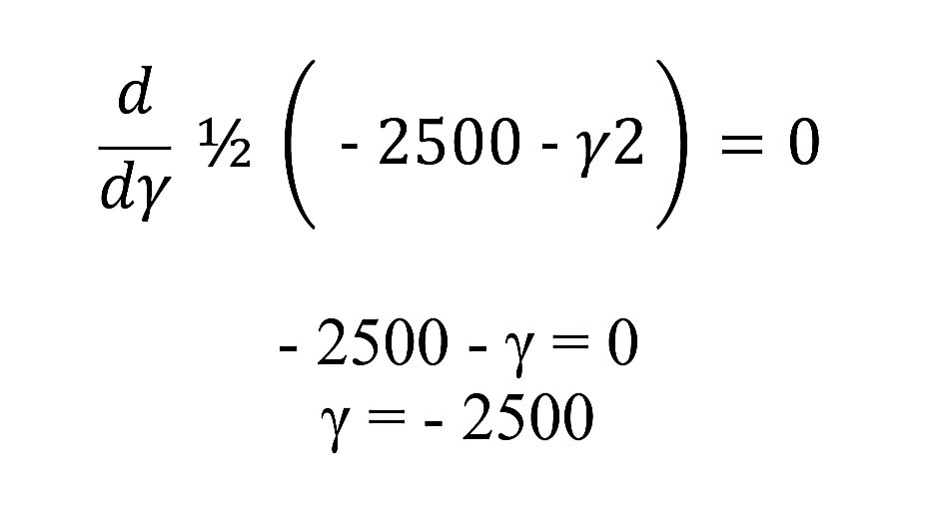
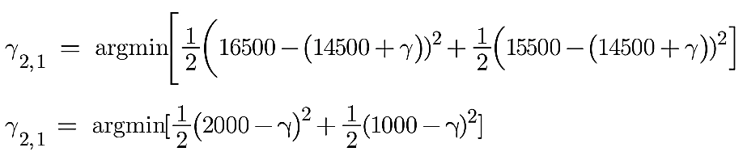
Now we need to find the value for gamma for which this function is minimum. So we find the derivative of this equation w.r.t gamma and put it equal to 0.
Hence the leaf R_{1,1} has an output value of -2500. Now let’s solve for the R_{2,1}.

Slide 40
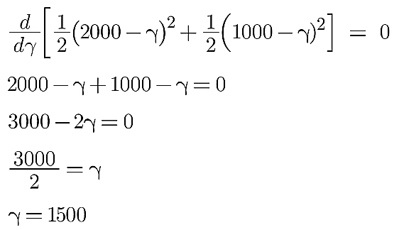
Let’s take the derivative to get the minimum value of gamma for which this function is minimum:
We end up with the average of the residuals in the leaf R_{2,1} . Hence if we get any leaf with more than 1 residual, we can simply find the average of that leaf and that will be our final output.

Slide 41


Now, after calculating the output of all the leaves, we get:
Step 5: Update Previous Model Predictions
This is finally the last step where we have to update the predictions of the previous model. It can be updated as:
where m is the number of decision trees made.

Slide 42

where m is the number of decision trees made.
Since we have just started building our model so our m=1. Now to make a new DT our new predictions will be:
Here, Fm-1(x) is the prediction of the base model (previous prediction) since F1-1=F0. Since F0 is our base model, the previous prediction is 14500.
nu is the learning rate that is usually selected between 0 to 1. It reduces the effect each tree has on the final prediction, and this improves accuracy in the long run. Let’s take nu=0.1 in this example.
H_{m}(x) is the recent DT made on the residuals.

Slide 43

Let’s calculate the new prediction now:

Slide 44


Slide 45


Slide 46


Slide 47


Slide 48


Slide 49


Slide 50


Slide 51


Slide 52


Slide 53


Slide 54


Slide 55


Slide 56


Slide 57


Slide 58


Slide 59


Slide 60


Slide 61


Slide 62


Slide 63


Slide 64


Slide 65


Slide 66


Slide 67


Slide 68


Slide 69

Solved Example 01

Slide 70


Slide 71


Slide 72


Slide 73


Slide 74


Slide 75


Slide 76


Slide 77


Slide 78


Slide 79


Slide 80


Slide 81

0.255

Slide 82


Slide 83


Slide 84


Slide 85


Slide 86


Slide 87


Slide 88


Slide 89


Slide 90


Slide 91


Slide 92


Slide 93
Serial | Chest pain | Blocked Arteries | patient weight | Heart Disease | Predicted_Heart Disease | sample weight | updated | normalized | Lower | Upper
1 | y | y | 205 | y |  | 0.13 | 0.04738538 | 0.071639648 | 0 | 0.07164
2 | n | y | 180 | y |  | 0.13 | 0.04738538 | 0.071639648 | 0.07164 | 0.143279
3 | y | n | 210 | y |  | 0.13 | 0.04738538 | 0.071639648 | 0.143279 | 0.214919
4 | y | y | 167 | y | misclassification | 0.13 | 0.329743057 | 0.498522467 | 0.214919 | 0.713441
5 | n | y | 156 | n |  | 0.13 | 0.04738538 | 0.071639648 | 0.713441 | 0.785081
6 | n | y | 125 | n |  | 0.13 | 0.04738538 | 0.071639648 | 0.785081 | 0.856721
7 | y | n | 168 | n |  | 0.13 | 0.04738538 | 0.071639648 | 0.856721 | 0.92836
8 | y | y | 172 | n |  | 0.13 | 0.04738538 | 0.071639648 | 0.92836 | 1
 |  |  | misclassification=1 |  |  | Sum= | 0.661440716
 |  |  | patient weight>176
 |  |  | error=1/8
Serial | Chest pain | Blocked Arteries | patient weight | Heart Disease | Predicted_Heart Disease | sample weight | updated | normalized | Lower | Upper
2 | y | y | 205 | y | y | 0.13 | 0.096864562 | 0.100041281 | 0 | 0.100041
4 | n | y | 180 | y | y | 0.13 | 0.096864562 | 0.100041281 | 0.100041 | 0.200083
6 | y | n | 210 | y | n | 0.13 | 0.161307703 | 0.166597865 | 0.200083 | 0.36668
4 | y | y | 167 | n | y | 0.13 | 0.161307703 | 0.166597865 | 0.36668 | 0.533278
4 | n | y | 156 | n | y | 0.13 | 0.161307703 | 0.166597865 | 0.533278 | 0.699876
6 | n | y | 125 | n | n | 0.13 | 0.096864562 | 0.100041281 | 0.699876 | 0.799917
8 | y | n | 168 | n | n | 0.13 | 0.096864562 | 0.100041281 | 0.799917 | 0.899959
7 | y | y | 172 | n | n | 0.13 | 0.096864562 | 0.100041281 | 0.899959 | 1
 |  |  | misclassification=3 |  |  | Sum= | 0.968245919
 |  |  | patient weight>176
 |  |  | error=3/8
Alpha01_patient weight | 0.972955
Alpha02_patient weight | 0.255413

Slide 95
Boosting vs Bagging
Boosting | Bagging
boosting works better for stable models like linear regression | Bagging can be used with unstable models like decision trees
boosting reduces bias | Bagging reduces variance
At every successive layer Models are weighted according to their performance. | All the models have the same weightage
New Models are influenced by the accuracy of previous Models | All the models are independent of each other
Works best with models that have low variance but high bias | Works best with models that have high variance but low bias

Slide 96

Stacking
The predictions from the base learners are stacked together and are used as the input to train the meta learner to produce more robust predictions. The meta learner is then used to make final predictions. Bagging and boosting typically use homogeneous base learners, whereas stacking tends to include heterogeneous ones.

Slide 97
Thank You

Slide 98
Boosting
Boosting improves machine learning performance by sequentially correcting errors and combining weak learners into strong predictors.
Each model iteratively focuses attention on the observations that are misclassified by its predecessors.
Models are added until either the complete training data set is predicted correctly or the maximum number of models are added. We’ve outlined the general process below:
Bagging → LB HV →LB LV Boosting → HB LV → LB LV

Slide 99
https://github.com/rushter/MLAlgorithms?tab=readme-ov-file

